Slide 1

Introduction to Algorand
Authors:
Matan Tenenboim,
Shlomo Hadar.
SCE – The Department of Software Engineering
GitHub Link

Slide 2
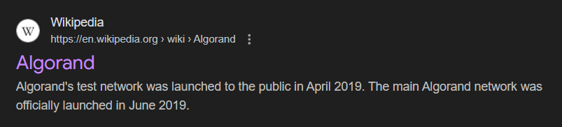

Slide 3
Definition: Algorand is a Proof-of Stake blockchain. Algorand's native cryptocurrency is called ALGO.
Proof-of-Stake (PoS) protocols are a class of consensus mechanisms for blockchains that work by selecting validators in proportion to their quantity of holdings in the associated cryptocurrency. This is done to avoid the computational cost of Proof-of-Work (PoW) schemes.

Slide 4
Recent Growth: In September 2024, the platform experienced a surge in user activity, with monthly active users increasing by nearly 34% from August, reaching a yearly high of approximately 1.34 million.
Transaction Speed: In May 2024, Algorand achieved a record of 5,716 transactions per second (TPS), placing it among the top three blockchains in terms of maximum recorded TPS.
User Base: By the end of Q1 2024, Algorand had accumulated a total of 35 million accounts, with an average of 800,000 monthly active users.
Daily Transactions: On January 1, 2024, the network reached an all-time high of 43 million transactions in a single day, demonstrating its capacity to handle substantial activity without performance issues.

Slide 5
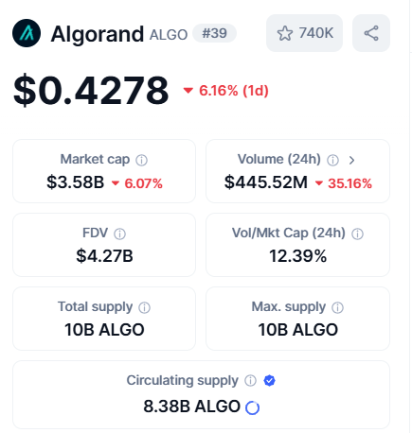

Slide 6
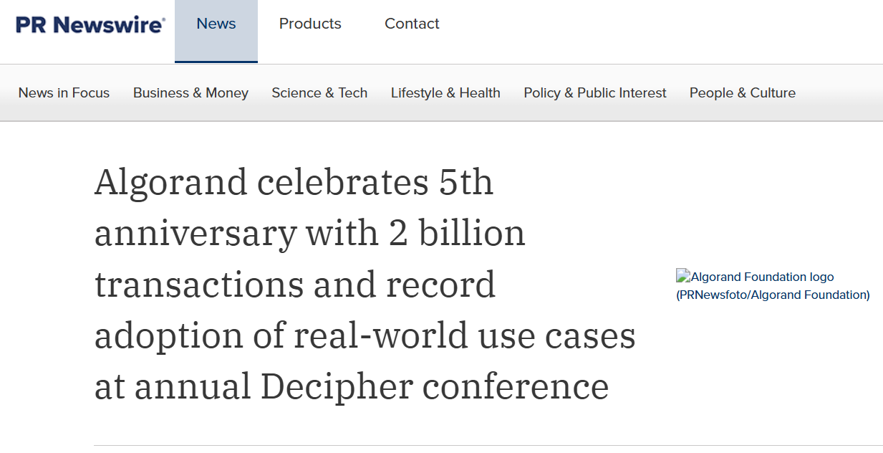

Slide 7
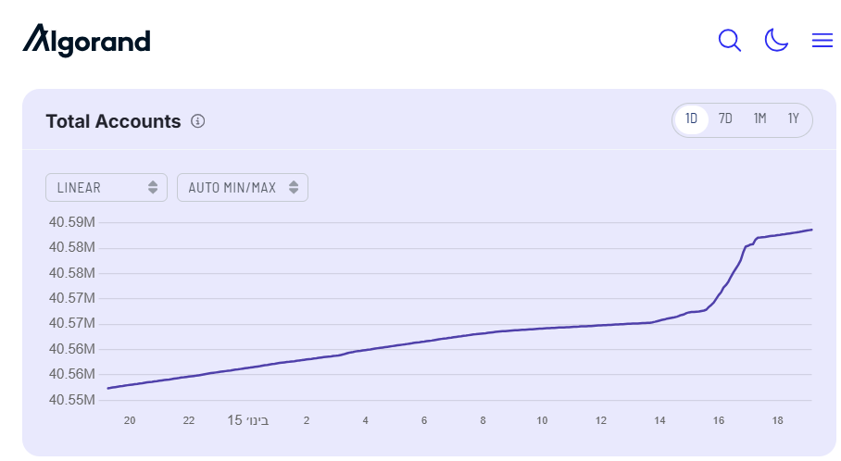

Slide 8
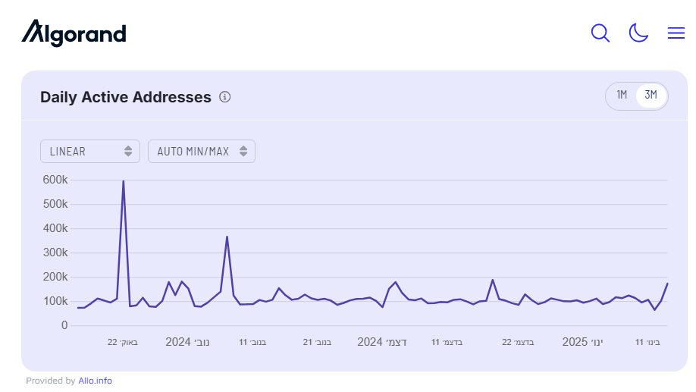

Slide 9
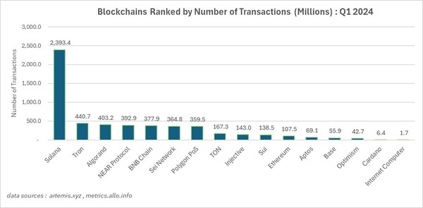

Slide 10
Purpose: A scalable and secure blockchain protocol.
Key Goals:
Low latency: Confirm transactions in under a minute.
No forks: Consensus ensures a single chain view.
High scalability: Supports millions of users without performance degradation.
Innovation: Combines Byzantine Agreement (BA⋆) with Cryptographic Sortition.

Slide 11
Cryptographic Sortition
Definition: A process for selecting users for roles (e.g., proposers, committee members) based on their stake (Proof of Stake).
Mechanism:
Verifiable Random Functions (VRFs) select users privately and securely.
Public seed ensures fairness.
Advantages:
Sybil attack resistance.
Lightweight and scalable.
Anonymity until selection is revealed.

Slide 12
Byzantine Agreement (BA⋆)
Phases:
Reduction Phase:
Narrows possible blocks to one valid block or an empty block.
Binary Agreement Phase:
Achieves consensus on the selected block.
Committee-based Voting:
Subsets of users vote at each step. (1000 members each vote)
Committees change dynamically to prevent targeting.
Key Properties:
Safety: No conflicting blocks are finalized.
Liveness: Guarantees progress under network conditions.

Slide 13
Key Theoretical Contributions
Innovations:
Weighted voting based on account balance.
Pseudo-random committee selection via VRFs.
Performance:
Scalable to millions of users with fixed-size committees.
Resilience:
Operates under both strong and weak synchrony assumptions.
Efficient fork recovery in rare cases of network partition.

Slide 14
Safety, Liveness, and Scalability
Safety:
All honest users agree on the same block.
Resistant to adversarial behavior with less than 1/3 stake.
Liveness:
Progress ensured with >2/3 honest stake.
No long delays in transaction confirmation.
Scalability:
Consensus remains efficient as user base grows.
Linear communication cost relative to committee size, not total users.

Slide 15
Live Demo🦔

Slide 16
Questions🐬

